Slide 1
Smart Agricultural Platform
Team Size: 11
Team Members:
Roshan Jagan, Naveen, Vamsi, Reddepa, Naresh, Dileep Reddy, Sunil, Jaswanth, Tosif, Jagadeesh

Slide 2

SignUp & Login: Farmer, Market Head can create account using mail.

Slide 3
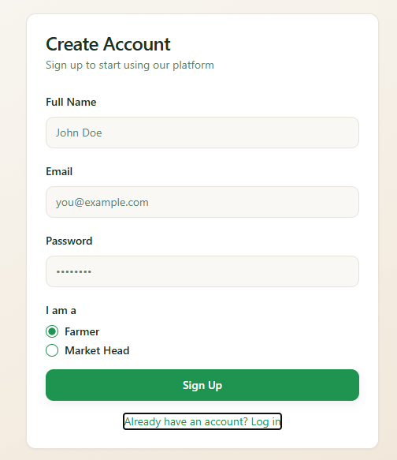
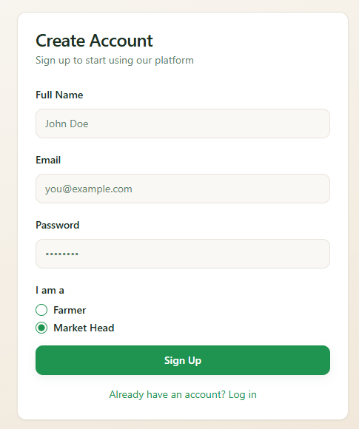

Slide 4
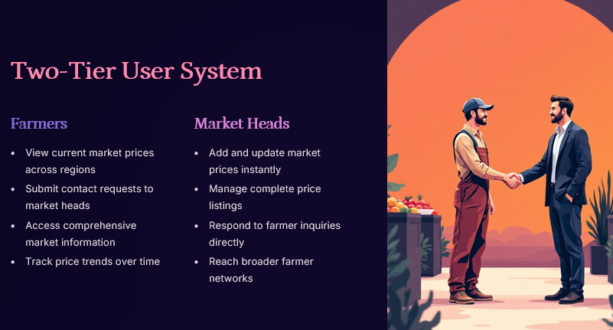

Slide 5
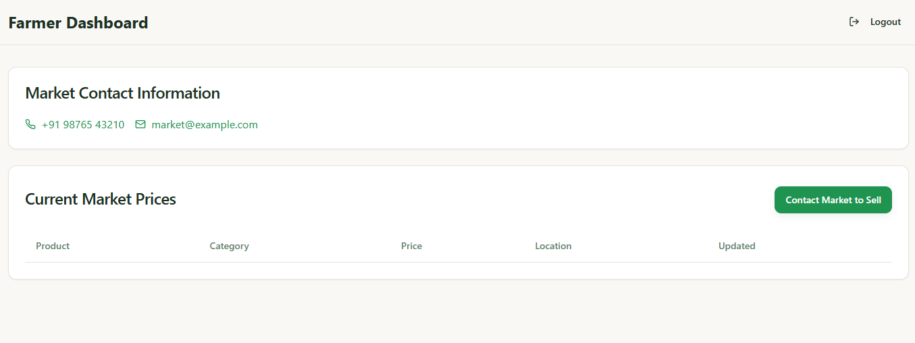

Slide 6
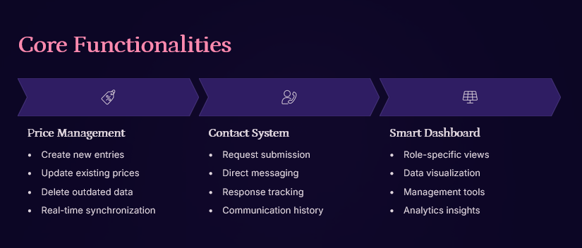

Slide 7
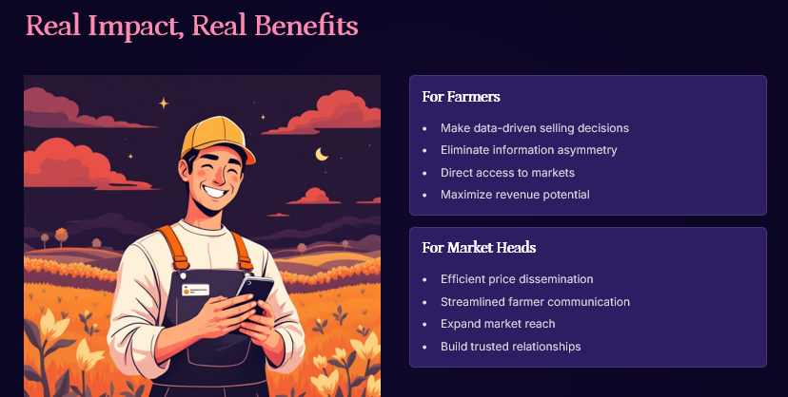

Slide 8
Thank You & Any Doubts???

